Slide 1

GOVERNMENT COLLEGE OF ENGINEERING,
ERODE
NAME OF THE STUDENT : Muthuramalingam B
NAAN MUDHALVAN REG NO: au731121106034
Under the mentor of
Dr. M. Sathyakala
Assistant professor , Dept of IT Department of Information Technology(IT)
Department of Electronics and Communication Engineering
Government College of Engineering
Erode ,Vasavi College post,TamilNadu-638316,
Affiliated to Anna University ,Chennai.

Slide 2

TRAFFIC MANAGEMENT SYSTEM
PHASE 4 DEVELOPMENT PART-2

Slide 3
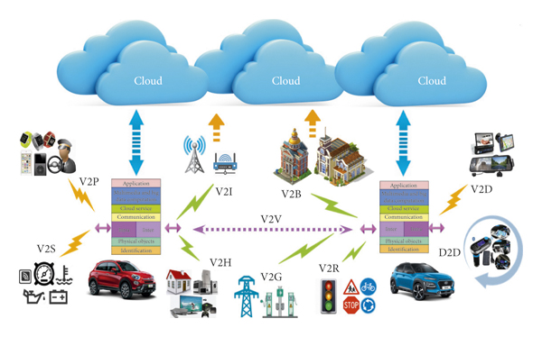
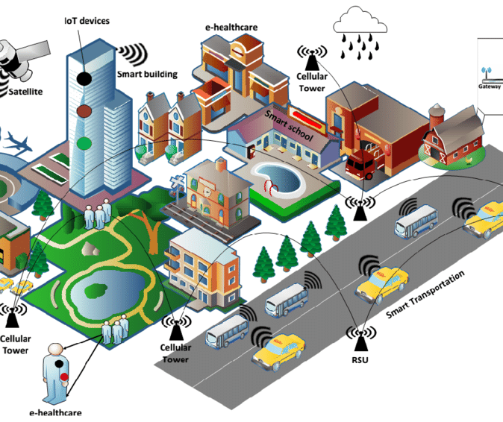
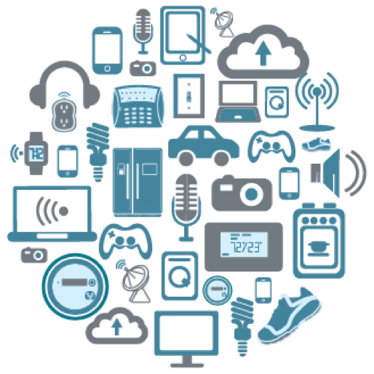
Introduction
In a world with growing population and increasing transportation needs, the cities need an intelligent traffic management system (ITS) which works based on traffic concentration on different lanes [1]. This system will be created to reduce waiting time at lanes and let the citizens travel to their homes, offices, schools and other destinations more quickly. The problem of unnecessarily waiting at signal, while other roads are empty is the cause of delay for people to reach their destinations. This problem is addressed here. The citizens will not be stuck in traffic for too long.

Slide 4
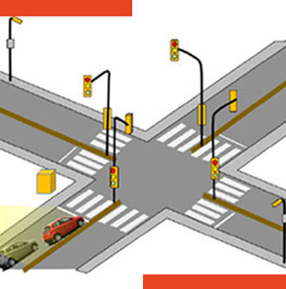
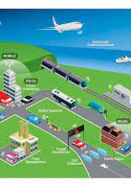
Traffic Signal Control: Implement a control system that allows traffic operators to make real-time adjustments to traffic signals based on data and traffic conditions. Enable traffic signal timing optimization to reduce congestion and improve traffic flow.
Traffic Data Analytics:
Apply data analytics and machine learning algorithms to derive insights from traffic data. Consider Python libraries like Pandas, NumPy, and scikit-learn for data analysis.
Develop predictive models for traffic congestion detection, accident prediction, or optimal traffic signal timing.
Create visualizations and reports for traffic operators and administrators.

Slide 5
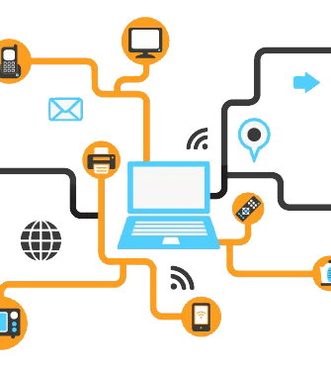
Front-End Development:
For the user interface, you will need a web application that can display traffic information and allow users to interact with the system.
HTML/CSS/JavaScript: The foundation of web development. Use HTML for structure, CSS for styling, and JavaScript for interactivity.
Front-End Framework: Consider using a front-end framework like React, Angular, or Vue.js for building dynamic and responsive user interfaces.
Real-Time Data Visualization: Use libraries like D3.js or Chart.js to visualize real-time traffic data in charts, graphs, or maps.
Mapping APIs: Integrate mapping APIs like Google Maps or Mapbox to display traffic conditions, road closures, and alternative routes.

Slide 6
Back-End Development:
The back-end of your web platform will manage IoT data, perform data analysis, and control traffic signals.
Server: Use a server framework like Node.js, Ruby on Rails, Django, or Flask to handle HTTP requests and manage IoT device communication.
Database: Store and manage IoT data in a database system like MySQL, PostgreSQL, or NoSQL databases (e.g., MongoDB).
IoT Data Processing: Implement data processing logic to aggregate and analyze data from IoT sensors and cameras.
Real-Time Communication: Implement WebSocket or other real-time communication technologies to receive and broadcast live traffic data updates.
APIs: Develop RESTful APIs to allow communication with IoT devices and to provide data to the front-end.

Slide 7
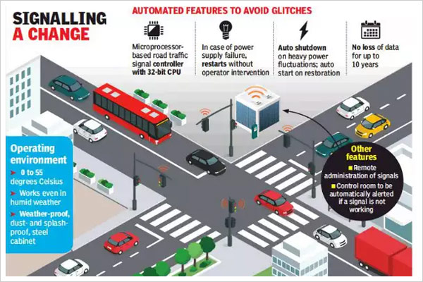
IoT Integration:
Ensure seamless integration with IoT devices and sensors that collect traffic data.
IoT Protocols: Use IoT protocols such as MQTT or CoAP for communication with IoT devices.
IoT Device Management: Develop a system to manage and monitor IoT devices, ensuring their reliability and security.
Authentication and Authorization: Implement secure authentication and authorization mechanisms to control access to IoT devices.

Slide 8
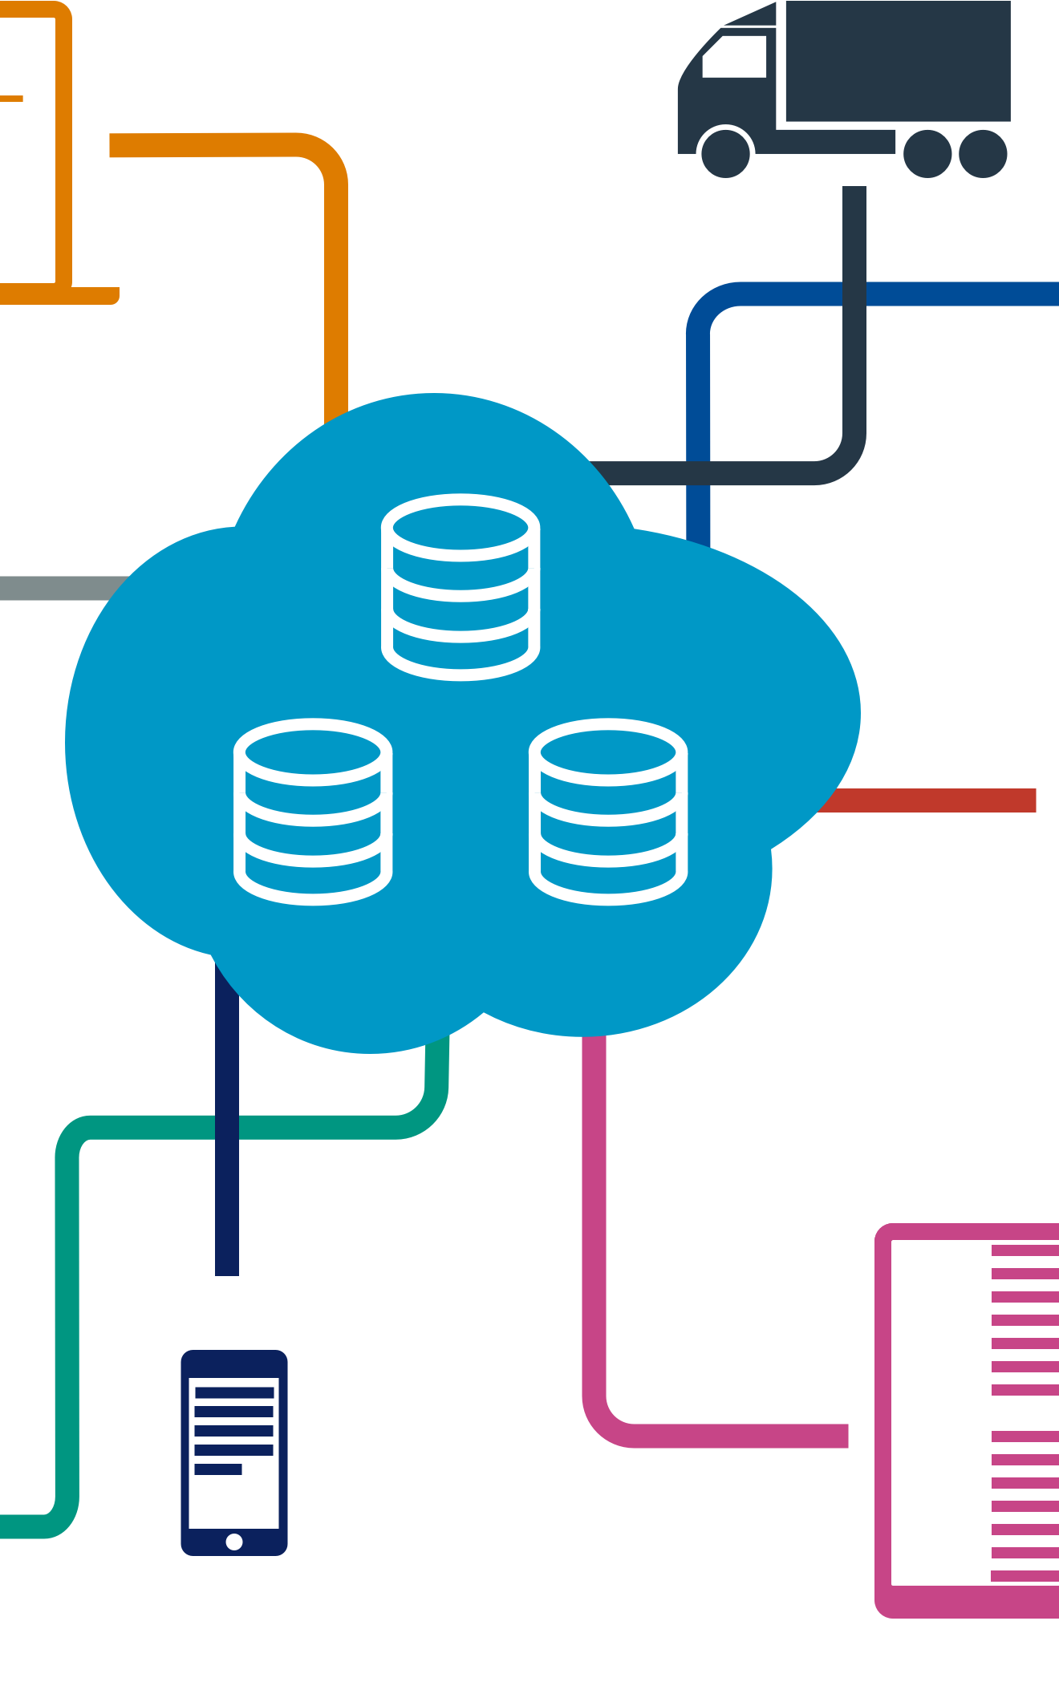
Data Analysis and Machine Learning:
Use data analysis and machine learning to make data-driven decisions for traffic management.
Data Analytics Tools: Utilize data analytics tools like Python libraries (e.g., Pandas, NumPy, scikit-learn) for data analysis.
Machine Learning: Implement machine learning models for predictive traffic analysis, such as predicting traffic congestion or accidents.
Alerting and Automation: Set up alerts and automation based on analysis results to optimize traffic signals and provide real-time information.

Slide 9

Security and Privacy:
Prioritize security measures to protect data and system integrity.
Authentication: Implement secure authentication for users, devices, and administrators.
Data Encryption: Encrypt data in transit and at rest to safeguard sensitive information.
Firewalls and Access Control: Set up firewalls and access control lists to protect the system from unauthorized access.

Slide 10
Scalability and Deployment:
Ensure the system can handle increasing data loads and traffic demands.
Cloud Services: Consider using cloud platforms like AWS, Azure, or Google Cloud for scalable hosting and data storage.
Load Balancing: Implement load balancing to distribute traffic evenly across multiple servers.
Continuous Integration/Continuous Deployment (CI/CD): Set up automated deployment pipelines to streamline updates and improvements.

Slide 11
User Support and Documentation:
Provide documentation for users, administrators, and developers, along with support channels for user inquiries and issues.

Slide 12
Regulatory Compliance:
Ensure your system complies with any local, state, or national regulations regarding data privacy, traffic management, and IoT device usage.
Building an IoT-based traffic management system is a complex and multifaceted project.
Collaboration with experts in IoT, web development, and traffic management is essential to ensure the project's success. Regular testing, monitoring, and maintenance are also crucial to keep the system running smoothly and securely.

